Slide 1
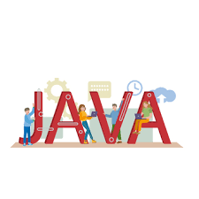
JAVA ARCHITECTURE
BY
MANI MANIGANDAN G G GG

Slide 2
INTRODUCTION
In Java, there is a process of compilation and interpretation.
The code written in Java, is converted into byte codes which is done by the Java Compiler.
The byte codes, then are converted into machine code by the JVM.
The Machine code is executed directly by the machine.

Slide 3
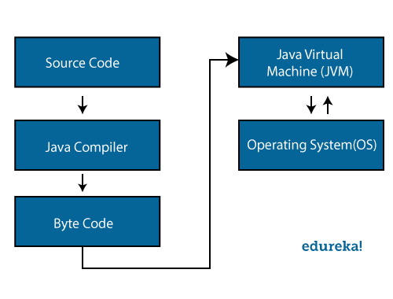
FLOW DIAGRAM

Slide 4
COMPONENTS
Java architecture comprises three main components:
Java Virtual Machine (JVM)
Java Runtime Environment (JRE)
Java Development Kit (JDK)

Slide 5
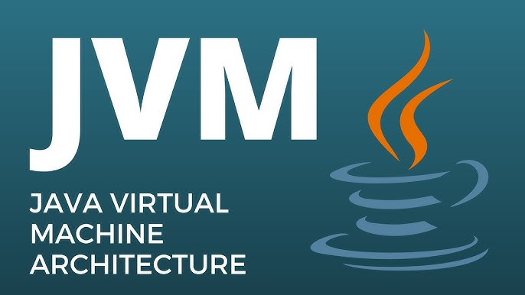
JAVA VIRTUAL MACHINE
The main feature of Java is WORA. WORA stands for Write Once Run Anywhere. The feature states that we can write our code once and use it anywhere or on any operating system. Our Java program can run any of the platforms only because of the Java Virtual Machine.

Slide 6
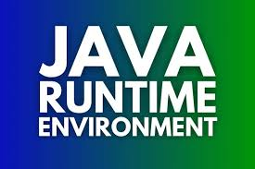
JAVA RUNTIME ENVIRONMENT
JRE creates a comfortable environment for Java applications to perform their best, taking care of memory management, garbage collection, and security. Think of the runtime environment as a well-equipped kitchen where chefs can focus on cooking delicious meals without worrying about ingredient availability or kitchen cleanliness.

Slide 7
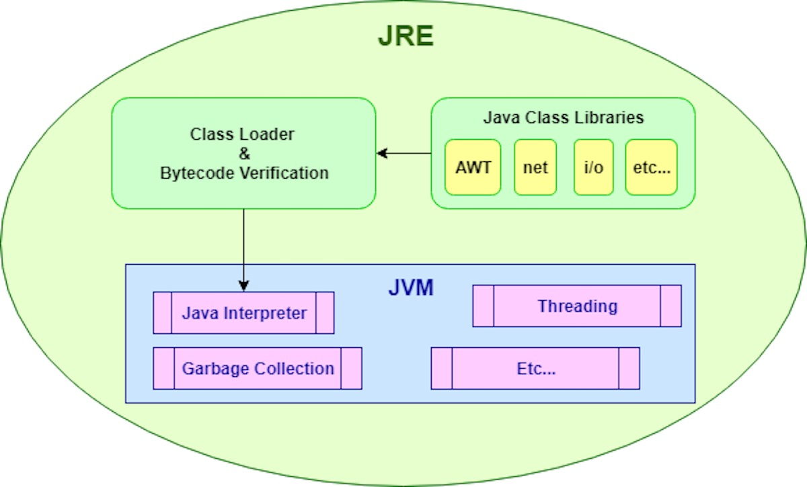
JRE FLOW DIAGRAM

Slide 8
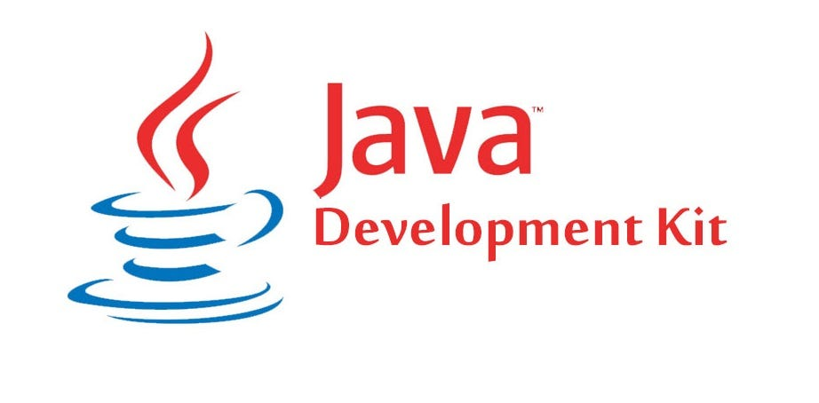
JAVA DEVELOPMENT KIT
Beginners often get confused with JRE and JDK, if you are only interested in running Java programs on your machine then you can easily do it using Java Runtime Environment. However, if you would like to develop a Java-based software application then along with JRE you may need some additional necessary tools, which is called JDK.

Slide 9
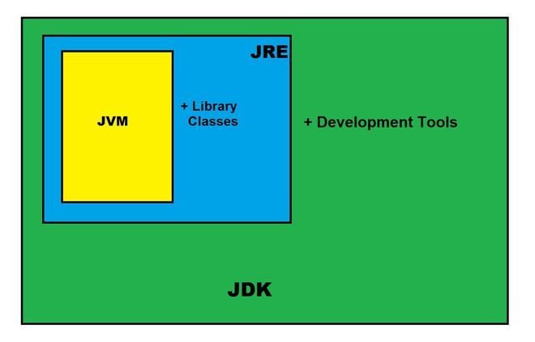
JDK FLOW DIAGRAM
JDK = JRE + Development Tools

Slide 10
CONCLUSION
Java architecture stands as a testament to the transformative power of a well-designed programming language and runtime environment. From its inception to the present day, Java has remained at the forefront of software innovation, enabling developers to overcome technological challenges and deliver impactful solutions across industries.

Slide 11


